Slide 1

What to look out for when migrating your data to the cloud: is it REALLY the right choice? 👀
Emanuele Meazzo

Slide 2
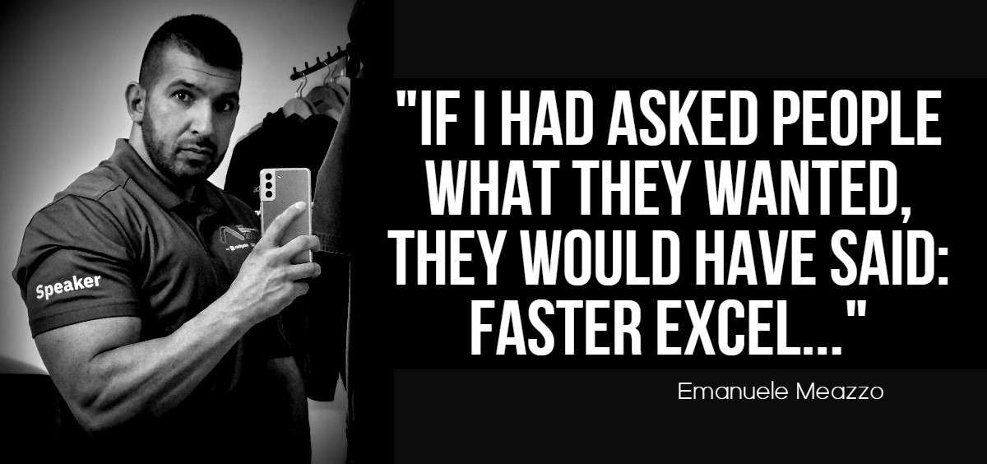
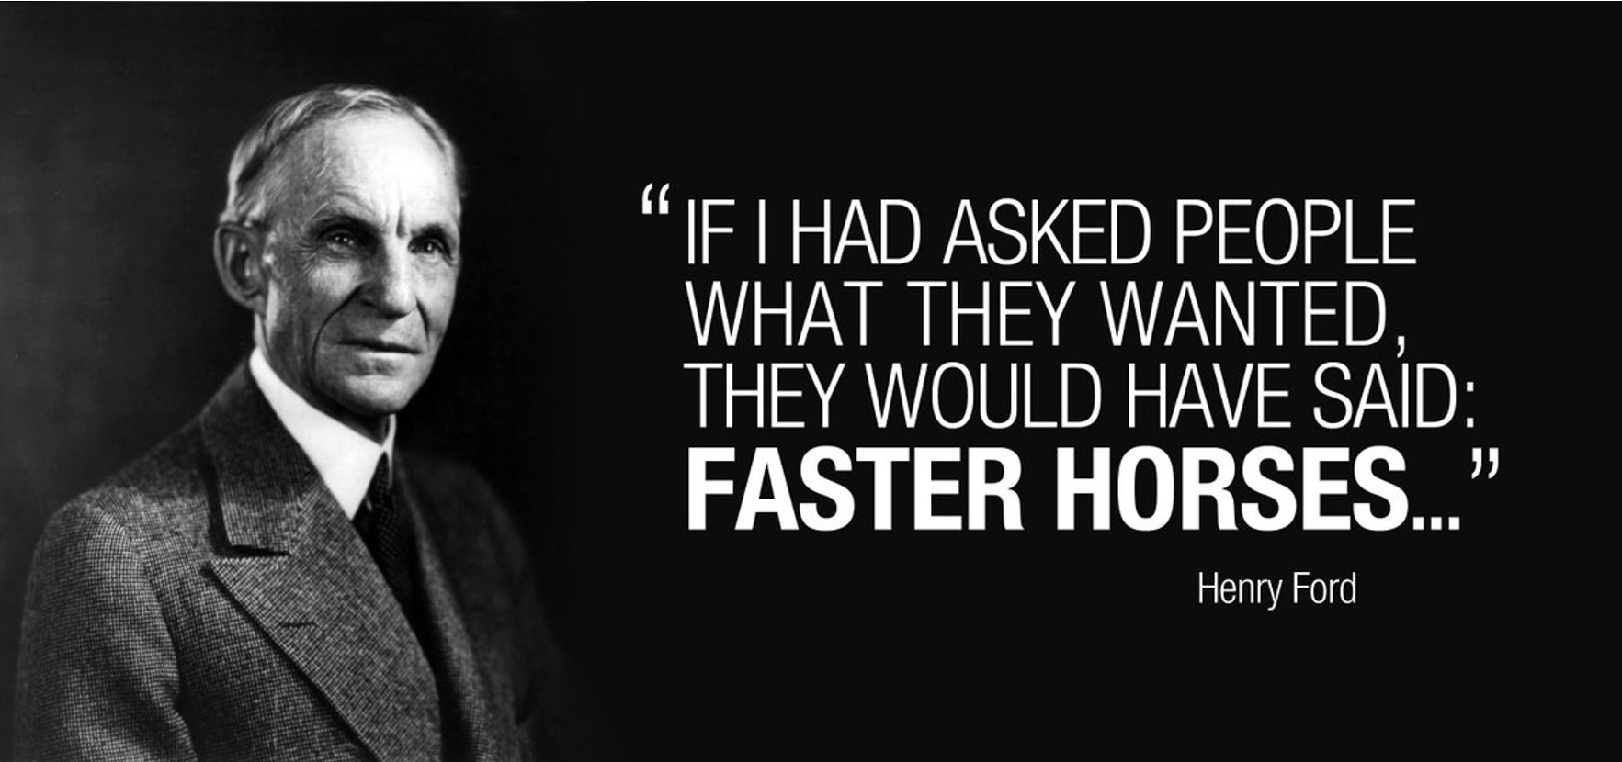





Emanuele Meazzo
Old time speaker 👴
Manager Data Science & Intelligence @ Acer EMEA
SQL Server, Azure SQL, Synapse, Data Lake Power BI, Azure AI, etc..
Ducks 🦆
linkedin.com/in/emanuelemeazzo
tsql.tech

Slide 3

“If someone asks me what cloud computing is, I try not to get bogged down with definitions. I tell them that, simply put, cloud computing is a better way to run your business
What is THE CLOUD?
—Marc Benioff, Founder, SalesForce

Slide 4

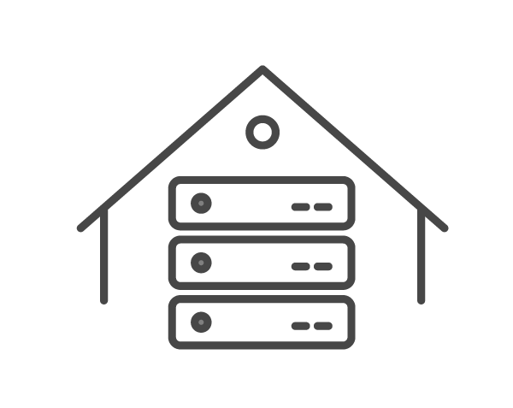

Where I got the idea for this session
ON-PREMISE
FULL CLOUD
Notes:
This is a not deeply technical presentation
But it’s cool since you can bring some of these points to your boss
Hopefully, everything should be trivial for you
If you’re already “in the cloud” and any of this isn’t trivial, sit down, we have to talk
The argument is so vast we could talk for hours, but there’s only 60 minutes, there will be gaps, we can continue at a different time, just ping me
Unfortunately, you’re going to leave this session with more questions than answers
Slides are text rich in order to be of reference for the future, you don’t need to read it all

Slide 5



⚠ DANGER ⚠
This session is to help you evaluate IF the cloud is a good choice for your company
There are no definitive answers, cloud adoption could become an incredible success or a terrible waste of resources
Knowing more will help you navigate the obstacles and choose your path, you’re welcome

Slide 6

But first, bear with me for a second

Slide 7
But first, bear with me for a second
We need a refresher on a couple of non-technical aspects

Slide 8
CapEx vs OpEX AK Why the business wants to move to cloud
CapEX Capital Expenses
OpEX Operational Expenses
Funds that companies use to purchase major physical goods or services used multiple years
Represent the day-to-day expenses necessary to run a business.
Notes:
CapEX: Usually approved through several layers of management (including executives), which will hold up purchasing until approval is received.
OpEx are fully tax-deductible in the year they are made.
This can be an attractive accounting option if the company has limited cash flow and wants to be able to deduct the total cost of an item in a tax year.
CapEx are recorded on the balance sheet
OpEx are recorded on the Income statement
CapEx only reduce taxes through the depreciation that they generate.

Slide 9


Types of Cloud Services
IaaS
Infrastructure
as
a
Service
PaaS
Platform
as
a
Service
SaaS
Software
as
a
Service
Getting rid of anything but the software configuration
Getting Rid of Physical Hardware
Getting Rid of installations and updates

Slide 10
New companies and the Cloud
It’s usually a no-brainer to start cloud-first
Cloud as a startup advantage
Cloud as a business model
No upfront investment in architecture
Lower capital risks
Faster creation of a MVP
Faster business pivoting
A SaaS product is easier
to try and to adopt
Saas Profit = EBITDA
Notes:
EBITDA: earnings before interest, tax, depreciation, and amortization

Slide 11
Existing companies and the Cloud
This is where the real planning and careful evaluation is needed
The following questions must be asked first:
1
2
3
What is my goal?
Cost savings?
New Product?
Faster Performance?
What does my current infrastructure look like?
Is the hardware at EOL?
Or is it just “slow”?
What technologies my team knows deeply?
Am I willing to invest in their formation and/or in new hires?
Notes:
And if the hardware is slow, it is because
There’s a problem with it?
The sizing was wrong in the planning phase
My team is not able to optimize the performances of the applications?

Slide 12
The State of the Cloud
81%
Of enterprises indicate that managing the cloud spend is a challenge
60%
Of organizations use cost efficiency/savings to measure cloud progress
64%
Plan to optimize the existing use of cloud (cost savings), making it the top initiative for the fifth year in a row
59%
More than 59 percent of enterprise workloads and data are or are expected to be in a public cloud within 12 months
28%
It’s estimated that organizations waste 28% of cloud spend, are over budget by an average of 18% and expect cloud spend to increase by 29% next year
Source: Flexera State of the Cloud Report 2023

Slide 13


Speed
All these changes are difficult to follow
50+
Most of the changes don’t require any action, the cloud vendor innovates for you
Azure updates per Quarter
The Cloud is FAST
Kalm
https://azure.microsoft.com/en-us/updates/

Slide 14
Multiple Vendors?
Everything in the same Cloud?
Use multiple Cloud Vendors?
PROS
PROS
Lower TCO (possibly)
Bundle licenses & discount tiers
No egress charges if in the same geographic area
Reduced data movement
Reduced ETL complexity
Easier to focus on optimizing a specific platform
Ability to hire specialized developers
Lowered Risk (?)
Higher Flexibility
Best of breeds solutions
CONS
Higher Costs
Egress fees
ETL costs to integrate data
Knowledge
Security (SSO)
Governance
Visibility
Monitoring and Logging
CONS
Suboptimal feature set (possibly)
If your provider decides to deprecate a critical feature for your business, you’re screwed
In case of a cloud provider that’s no longer competitive, the whole IT stack needs to be moved over
Having said this: 92% of Enterprises have a multi-cloud strategy
Should you put all your eggs in one basket? Thinking about Database eggs and Cloud baskets | T-SQL Tech
Notes:
Not citing Hybrid Clouds, I’m counting it as a single cloud vendor

Slide 15
Ok, let’s go a bit deeper into the topic Finally.

Slide 16
The DataLake trap (aka continuous upselling)
I’ve seen countless companies burning large amounts of cash in search for the “big data”
solution, only because the management* was driven by the Big Data hype
Is the reported failure rate of Big Data enterprise projects
Avoid dumping data into a big bucket just because “now you can” using cloud tools.
Saving money means first and foremost not throwing them away in a project that
will never see the light of the day.
Ask yourself: What is the problem that I’m trying to solve with this?
60-85%
Source
The Success & Resounding Failure of “Big Data”

Slide 17
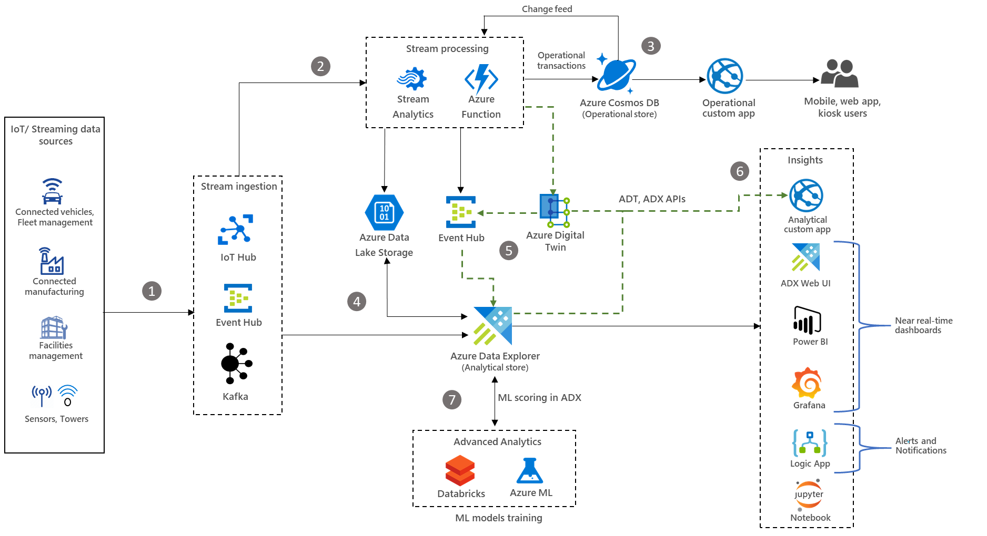
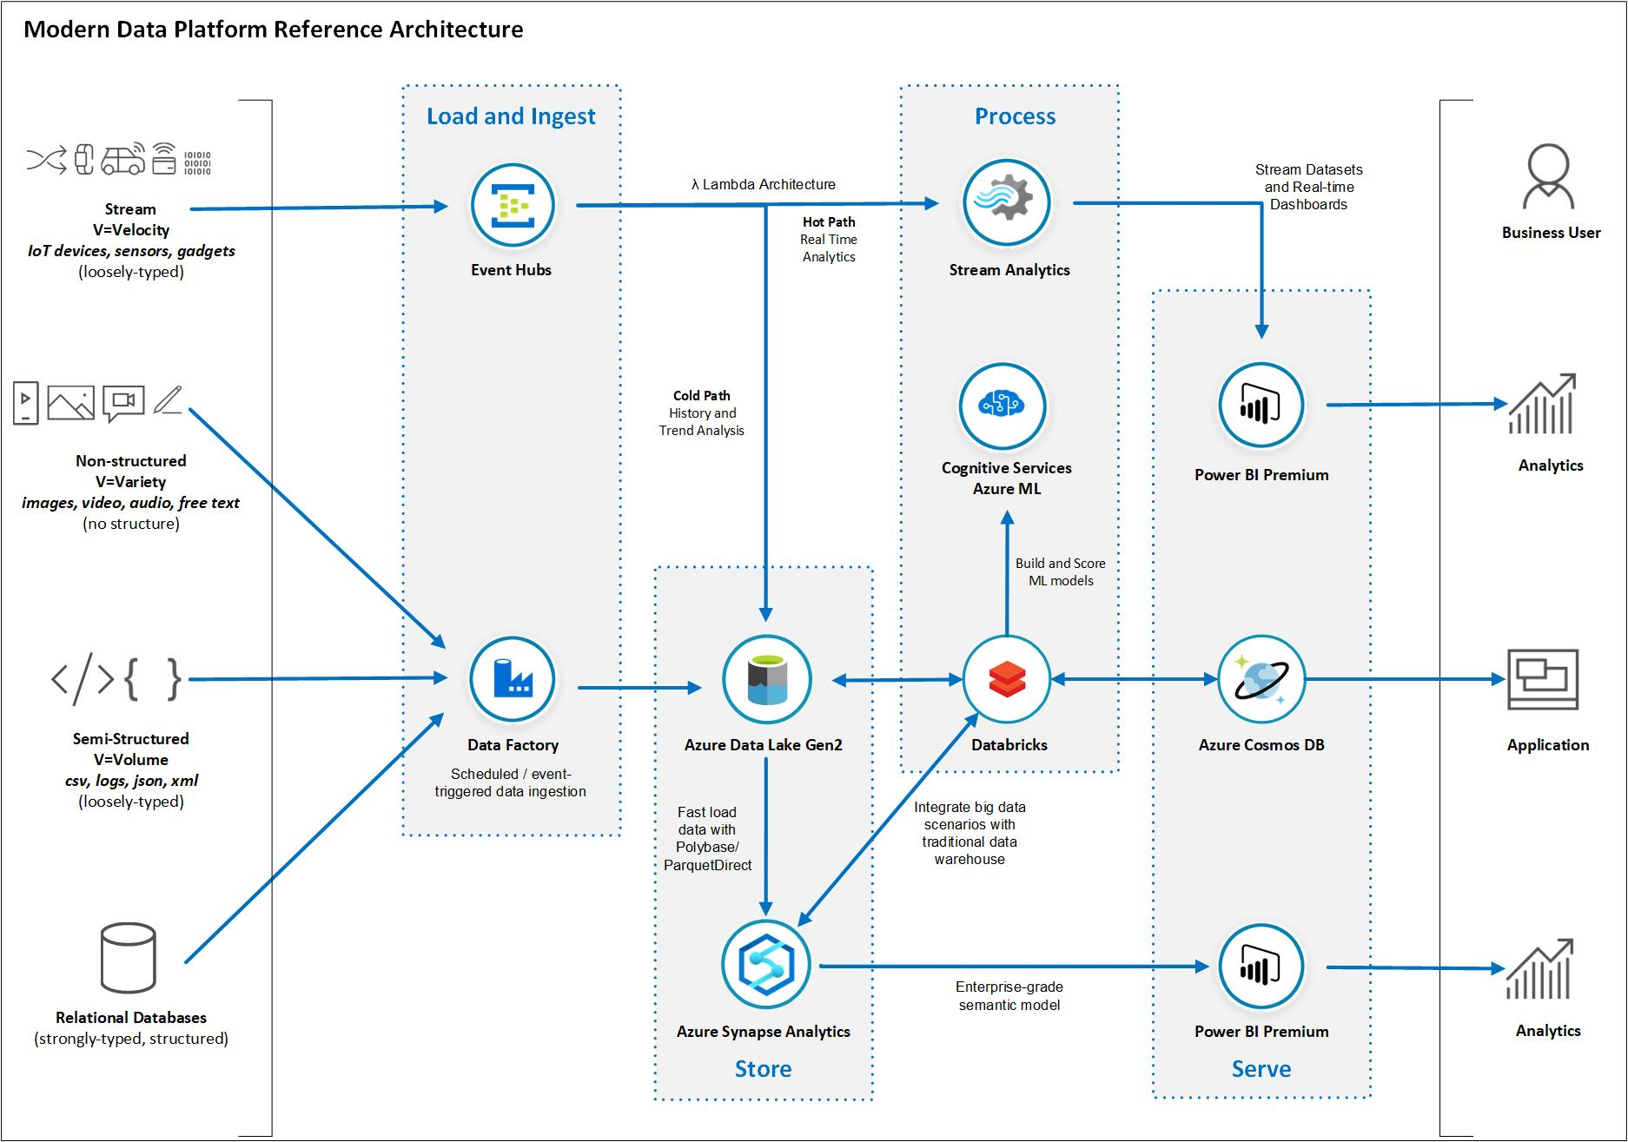
The trap, continued
Choose the right technology for you.
The market is full of buzz-words, everything is real time, petabyte scale, streaming rich data.
What do I need to do?
What’s the problem I’m trying to solve?
What’s the business requirement behind all of this?
In the cloud architecture examples you see on the web, you’ll see lots of services communicating with each other
Any vendor is very happy to sell you all the cloud services you need, or even better everything they think you need

Slide 18
Sorry, probably, your apps need to change

Slide 19

My apps need to change !?!?
That’s the main point of all of this, there is no real Cloud transformation without a change in your ways
No more “It always has been done like this”
If you want to do what you’ve always done, but in the cloud, you’ll rarely see real benefits from it.
Now, let’s see some of the typical hurdles of cloud adoption 👀
YES.

Slide 20

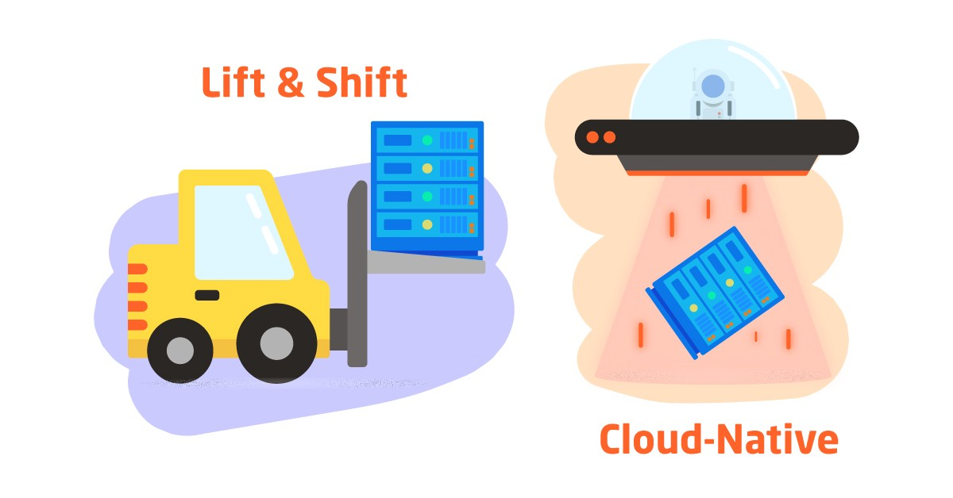
Thinking why you’re Lifting & Shiftin’
Vs
A classic business move to get to the cloud “fast”
Can be a good short-term solution (or a long term one for non business critical systems)
Good move for legacy system with EOL hardware with an hardware refresh planned
Infrastructure costs are higher than continuing to use your servers, if you already own them
Cannot use 90% of the features that makes the cloud more efficient
You’re basically renting someone’s else server instead of your own (also, the network)
Image Source

Slide 21


Mind the Network and Expect Latency
Especially if you Lift&Shift parts of your application/data to the cloud,
latency can bite you
Not necessarily because cloud latency is bad
Maybe you’re used to the sub-ms latency of your server which was sitting in the closet behind you, and now your chatty application is trying to get data from the other side of the world.
For existing apps, verify the level of chattiness and how latency affects them

Slide 22
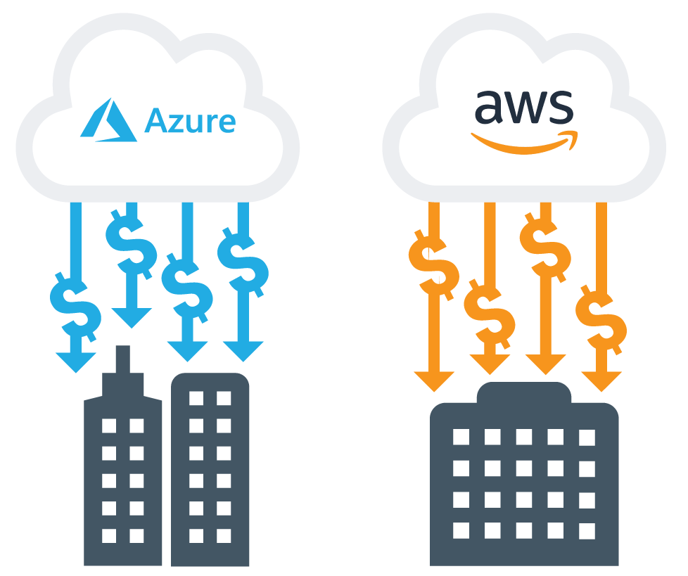
Mind the Egress Fees
Be careful, it’s not like your good ‘ol datacenters, you’re going to pay for it
While importing data is mostly free, moving data out always costs you money
Azure Sample Pricing:
100GB-10TB/Month: $0.08 per GB ~ $800/month (10TB)
10TB/40TB/Month: $0.065 per GB ~ $3466/month (50TB)
So, be careful when moving big amounts of data.
But wait, there’s more!
You pay for intra-cloud data movement too! And I’m not talking like between different cloud providers
azure.microsoft.com/en-us/pricing/details/bandwidth/#pricing
Data Egress: What is it and how much does it cost? (getdeploying.com)
Notes:
Don’t be like NASA that had to pay a theoretical $12M to download their 247PB of Data
Consider yourself lucky, amazon charges ingress fees too, for ingesting data into EC2s

Slide 23
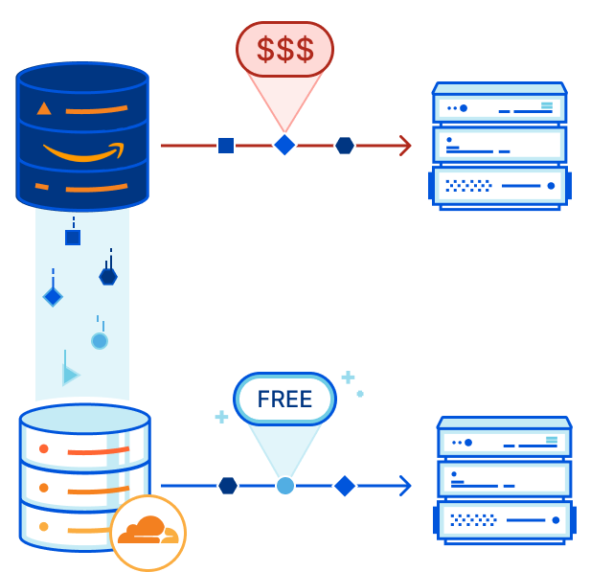
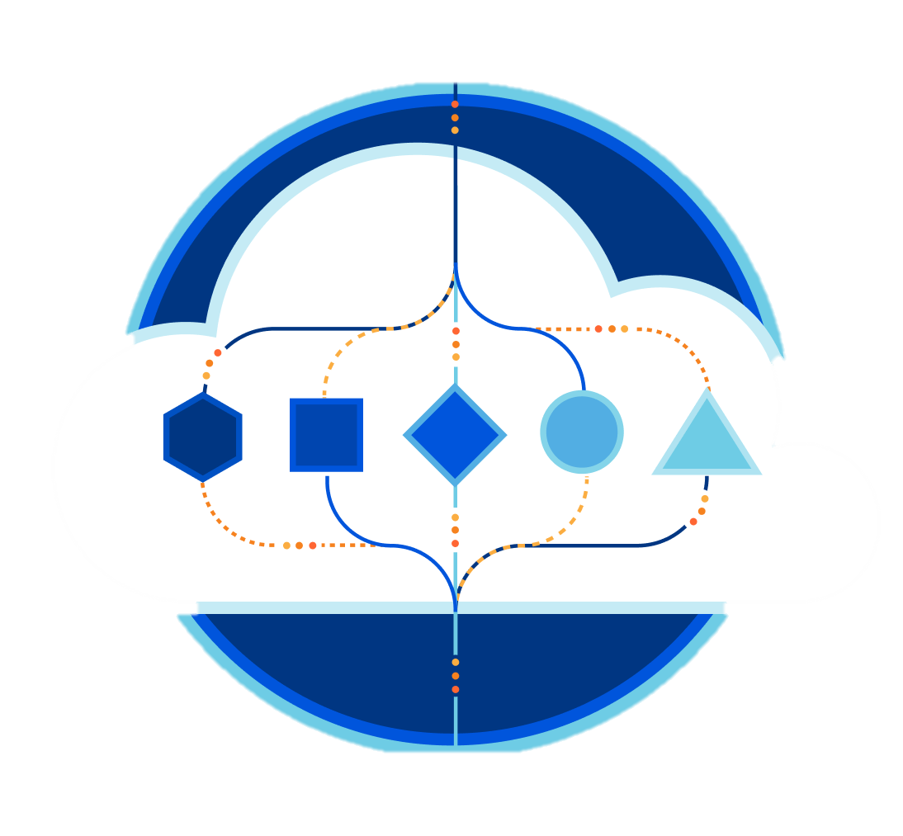
Egress tip: Cloudflare R2

Slide 24
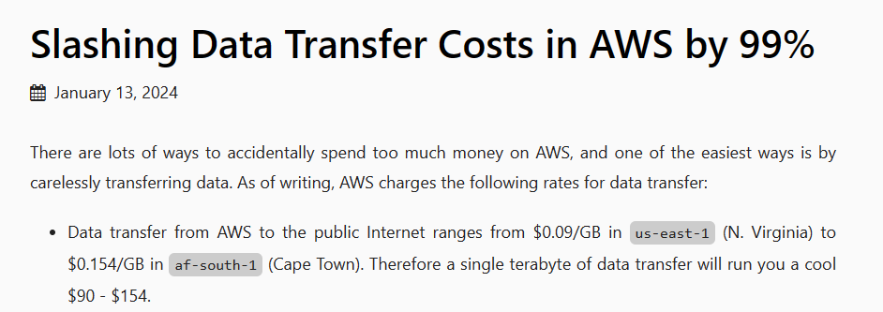
Bonus Egress Tip
Read this article by Daniel Kleinstein
Notes:
Slashing Data Transfer Costs in AWS by 99% · Bits and Cloud

Slide 25


Trivia
Things you can say to your cloud
vendor but not your partner in bed
I want it to be FAST and CHEAP

Slide 26
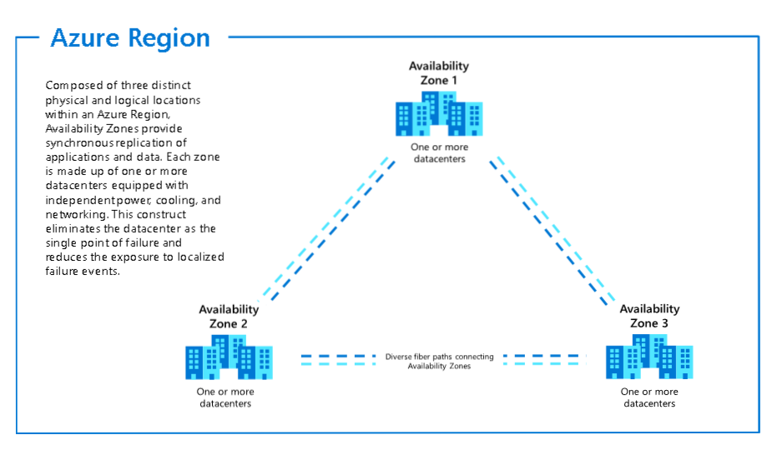
Control where your data is
After the two previous slides, you should have realized that data location is somewhat important
It’s all a game of balancing the following:
Region exclusivity: Keep all traffic within the same region. If traffic needs to exit a region check and choose the region with the lowest transfer rates
Region Proximity: The closer the cloud region to your premise and/or users, lower the latency
AZ exclusivity: In both AWS and Azure traffic within the same Availability Zone is free.
Geo Replication: Critical data, that needs a very tight SLA should be replicated, make sure it’s worth it

Slide 27
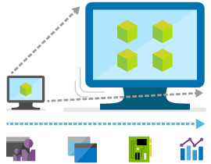

Consider Scaling Services
You can get most of the cost savings by simply being able to scale up/down cloud resources, or even better being able to turn them off completely
If you’re using a cloud VM like an on-prem one, in a never-changing configuration, what’s the point of it being physically more distant from your premise and managed by a third party?
At the same time, the scaling considerations to make are
Different than on-prem:
How can this service scale?
Can it be turned off?
How long does scaling take?
Does my application support horizontal data scaling or does it need to be baked into the data layer?
Does this dev instance really need to stay on 24/7 ?

Slide 28
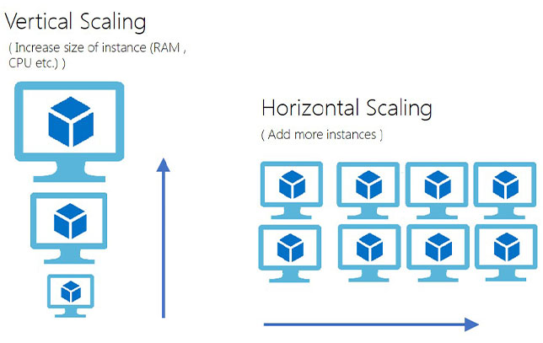
More considerations on Scaling
Depending on the service, scaling up and/or down may not be seamless, and service interruptions may happen (from a simple drop of connections to long service interruption)
Due to the above, any cloud-ready application should integrate a retry logic for any call to any service, especially to the persistence layer
Does the service scales automatically up and down depending on the load, or you have to programmatically scale it yourself?
While vertical scaling can be almost transparent (except the downtime), a horizontal scaling isn’t, if your application isn’t already in the cloud mood; do you even know how it scales?
If your data starts getting spread across various locations, you really have to think about how to distribute it

Slide 29
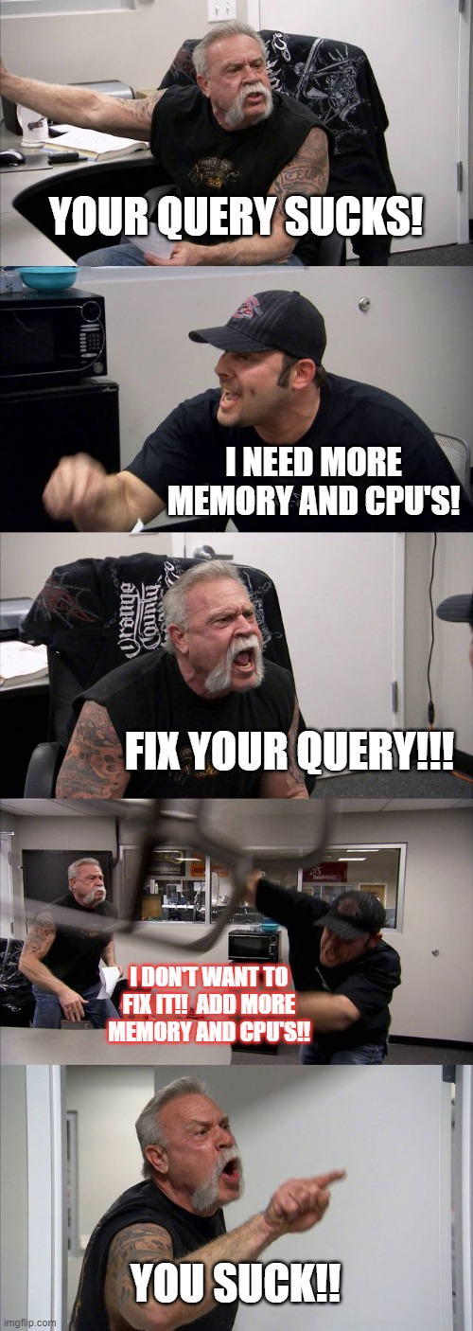
Performance is (literally) money
Scaling up usually happen for two reasons:
A good one: an increased request volume to your system
A bad one: a performance problem that’s being fixed by blindly throwing hardware at it
While the short-term solution for a performance problem could be just throwing more resources at it, it should be just a way to get more time for your devs/dbas to fix the performance issues.
Since in the cloud we’re basically renting someone’s else hardware, using way more than necessary because no effort has been spent in optimizing the data access is an expensive mistake.
Performance Tuning on the cloud will save you money by the hour | T-SQL Tech

Slide 30
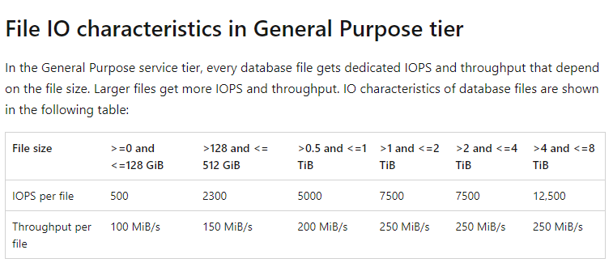
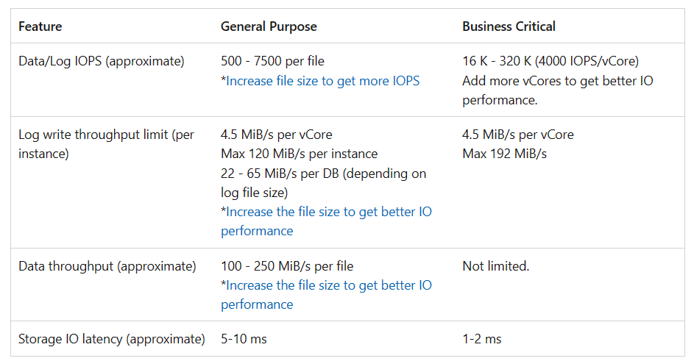
Please 🙏 mind the IOPS/Throughput limits
When selecting a Paas database, read carefully the whole spec sheet
IOPS can become a limiting factor if not considered, when coming from OnPrem
Of course these numbers are often buried inside the documentation of the product, but they need to be taken into consideration

Slide 31
Reservations on Reservations
Reserving capacity on the cloud is a nice way to save money. All the major Cloud vendors offer discounts when opting for reserving a service for 1+ years, even up to 60% on the overall TCO
This is of course a great way to save money, but only if you do the following:
Make sure that the resource must stay online for a percentage of time greater than the discount applied
Measure your current workload
Make sure that you’re buying a resource be appropriate for the whole reservation period (While you can often exchange your reservation for another resource, it’s usually only for upselling, not down)
Understand that you’re reserving the price, not the hardware itself

Slide 32
Kill unused resources
Creating resource on the cloud is very easy, so much that’s not uncommon to create something just for testing purposes and leaving it be for the time being.
The fact that some vendors makes it purposefully difficult to have an overview of everything that’s deployed on a specific subscription surely helps with the above.
Review your cloud spending every month
Keep an eye on your resource inventory
Use the integrated vendor tools for budgeting and cost allocation to identify which project/area is responsible for the most expenses and optimize it

Slide 33
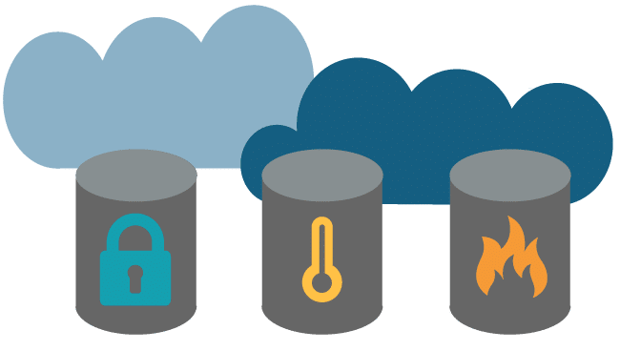
Storage Tiering & cleaning
Storage is “cheap” but when you start storing all kind of data in the cloud the bill starts to grow too
If you have data that you really know you’re not going to use, ever, get rid of it
For all the rest, choose an appropriate storage tier: “Hot” data is accessed frequently and/or needs a fast retrieval, hence it needs a fast storage
“Cool” data doesn’t have the same performance requirements, so, it can be stored someplace where you can wait a little bit to fetch your data
“Archive” is the cloud equivalent of tapes, you may wait for hours to get your data, but it’s cheap
PS: All your data needs to be archived as is or it can be aggregated first?

Slide 34
The cloud is not supposed to be cheaper
It’s a cheat code around bare metal
It’s a wrapper for convenience
It’s exploiting someone else’s economy of scale
It’s flexibility and fast deployments

Slide 35
The Cloud DBA
Basically, still
“It depends”
But now in Cloud, with more variables
Troubleshoot Outages
Patching
Backups
Install, config SQL
Install, config OS
Platform Architecture
Cost Management
Performance Optimization
Configure Scaling

Slide 36
Keeping Up
Learning has changed in the cloud days too
The technology changes so fast that’s often not cost-effective for
third parties to create in-depth courses about the newest tech,
as it could be obsolete by the time the course is ready
Big Books are a thing of the past for the same reason
To stay up to date, use these resources:
Blogs (remember to check out mine!)
Vendor Blogs & Documentation
Conferences (like this one ☺ )
Vendor-organized “hands on” events
Set up your own (small) instance and mess with it

Slide 37
Azure Specific Tips
Use DEV/Test pricing for, well, your dev/test resources (but consider Visual Studio Subscriptions cost)
If you have an intermittent workload, take notice of the Burstable VM types (B-Series)
Be sure to also delete attached resources when deleting a VM (this is now easier than ever thanks to new delete options gone GA last year)
Microsoft is supposed to Price-match any other Cloud vendor for the same service every 3 months, if they haven’t done so, try and ask why ☺

Slide 38
TCO/Pricing Calculators
Total Cost of Ownership (TCO) Calculator | Azure
AWS Pricing Calculator
Google Cloud Pricing Calculator

Slide 39
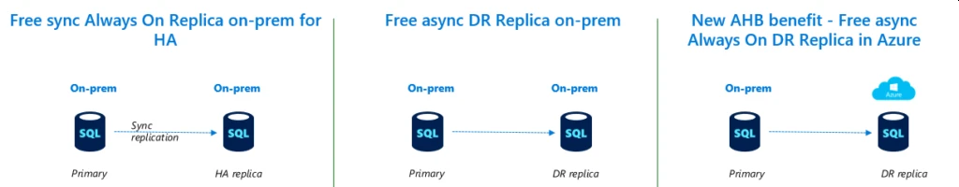
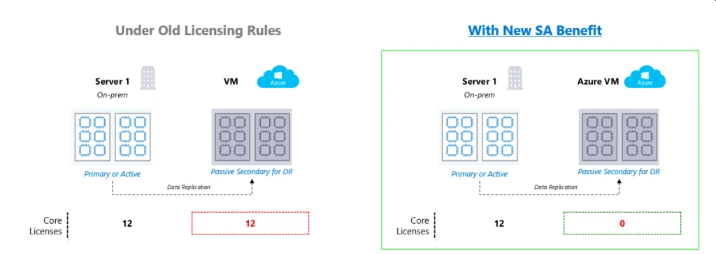
Take advantage of Licensing
Licensing changes in SQL Server introduced in the 2019 version, but applicable to all SQL versions, include the following benefits (with Software Assurance):
In addition to the high availability and disaster recovery benefits, the following operations are allowed on the passive replicas:
Database consistency checks
Log backups
Full backups
Monitoring resource usage data

Slide 40


